Slide 1
Chapter 8 Main Memory

Slide 2
教学内容、目标与要求
教学内容
内存管理基本问题
交换
连续内存分配
页式管理
页表结构
段式管理
段页式管理
教学重点与难点
重点：4、5、7
难点：4、7
教学目标与要求
理解并掌握内存硬件的各种组织方法；
掌握各种内存管理技术。

Slide 3
About Main Memory Management
Goals of Memory Management
Subdividing memory to accommodate multiple processes.
Memory needs to be allocated efficiently to pack as many processes into memory as possible.
Memory Management Requirements
Relocation
Programmer does not know where the program will be placed in memory when it is executed.
While the program is executing, it may be swapped to disk and returned to main memory at a different location (relocated).
Memory references must be translated in the code to actual physical memory address.
资源共享，提高利用率

Slide 4
About Main Memory Management
Memory Management Requirements(Cont.)
Protection
Processes should not be able to reference memory locations in another process without permission.
Must be checked during execution
Impossible to check absolute addresses in programs since the program could be relocated.
Operating system cannot anticipate(预测) all of the memory references a program will make.
Sharing
Allow several processes to access the same portion of memory.
Better to allow each process (person) access to the same copy of the program rather than have their own separate copy.

Slide 5
About Main Memory Management
Memory Management Requirements(Cont.)
Logical Organization
Programs are written in modules.
Modules can be written and compiled independently.
Different degrees of protection given to modules (read-only, execute-only).
Share modules
Physical Organization
Memory available for a program plus its data may be insufficient.
Overlaying allows various modules to be assigned the same region of memory
Programmer does not know how much space will be available.

Slide 6
Contents
8.1 Background
8.2 Swapping
8.3 Contiguous Memory Allocation
8.4 Paging
8.5 Structure of the Page Table
8.6 Segmentation
8.7* Example: The Intel Pentium

Slide 7
8.1 Background
Memory consists of a large array of words or bytes, each with its own address.
The program must be brought into memory and placed within a process for it to be run.
Main memory and registers are only storage CPU can access directly.
Register access in one CPU clock (or less).
Main memory can take many cycles of the CPU clock, causing a stall(停顿）. It does not have the data required to complete the instruction.
Cache sits between main memory and CPU registers.
typically on the CPU chip.

Slide 8
Background
A typical instruction-execution cycle:
Fetch an instruction, decode instruction, fetch operands, execute, store results back into memory.
Memory Unit only sees:
a stream of addresses + read requests, or
address + data and write requests.
Protection of memory required to ensure correct operation.
This protection must be provided by the hardware.
make sure each process has a separate memory space.
ability to determine the range of legal addresses that the process may access and to ensure that the process can access only these legal addresses.

Slide 9
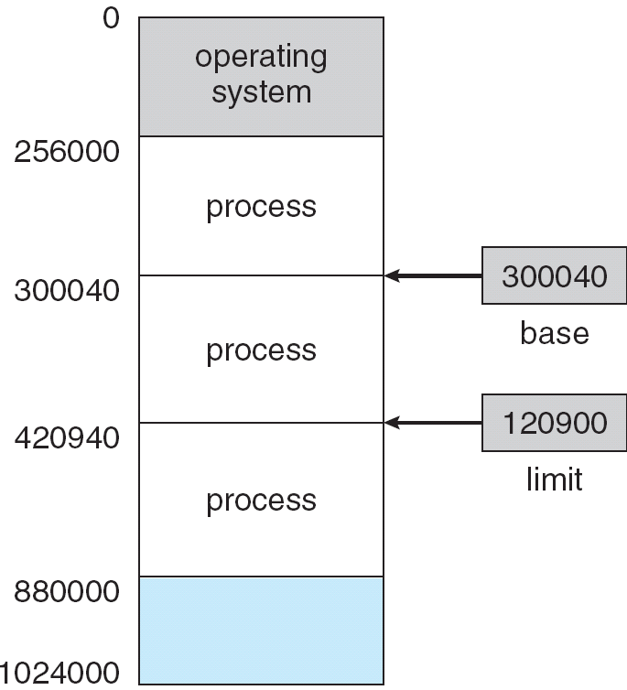
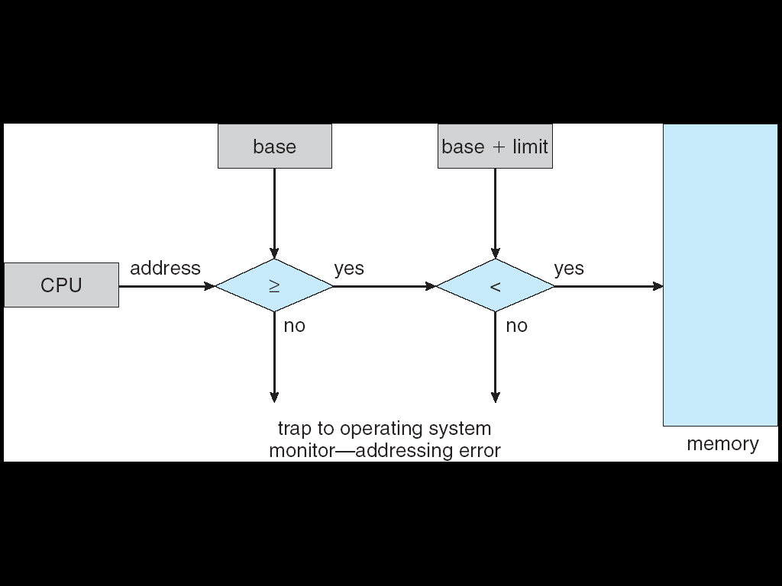
Protection: Base and Limit Registers
base and limit registers define the physical address space.
CPU must check every memory access generated in user mode to be sure it is between base and limit for that user.
The base and limit registers can be loaded only by the OS, which uses a special privileged instructions.

Slide 10
Address Binding
Programs on disk, ready to be brought into memory to execute form an input queue.
Most systems allow a user process to reside in any part of the physical memory.
A user program goes through several steps before being executed. Addresses represented in different ways at different stages.
Addresses in source program are usually symbolic. E.g. counter
A compiler binds symbolic addresses to relocatable addresses. E.g. “200 bytes from beginning of this module”
Linker or loader will bind relocatable addresses to absolute addresses. E.g. 74014.
Each binding maps one address space to another.

Slide 11
Multistep Processing of a User Program
source program
counter
compiler or assembler
Compile time
other object modules
object module
1200
200
linkage editor
system library
load module
load time
dynamically loaded
System library
loader
200
1200
in-memory
Binary Memory image
run time
1200

Slide 12
Address Binding-- Compile time
source program
complier
loader
running
Name spece
⇒
Logical space
⇒
Physical space
1000
1000
……
Load R1, data
……
6817
……
……
Load R1, [1200]
……
6817
……
……
Load R1, [1200]
……
6817
……
1100
1100
data：
1200
1200
1299
1299
absolute code is generated

Slide 13
Address Binding-- Load time
source program
complier
loader
running
Name spece
⇒
Logical space
⇒
Physical space
0
1000
……
Load R1, data
……
6817
……
……
Load R1, [200]
……
6817
……
……
Load R1, [1200]
……
6817
……
100
1100
data：
200
1200
299
1299
relocatable code is generated

Slide 14
Address Binding-- Execution time
source program
complier
loader
running
Name spece
⇒
Logical space
⇒
Physical space
0
1000
……
Load R1, data
……
6817
……
……
Load R1, [200]
……
6817
……
……
Load R1, [200]
……
6817
……
100
1100
data：
200
1200
299
1299
relocatable code is generated
translate 200 to 1200

Slide 15
Binding of Instructions and Data to Memory
can be done at three different stages.
Compile time If memory location known a priori, absolute code can be generated.
Must recompile code if starting location changes.
Load time Must generate relocatable code if memory location is not known at compile time.
If the starting address changes, we need only reload the user code to incorporate this changed value.
Execution time Binding must be delayed until run time if the process can be moved during its execution from one memory segment to another.
Need hardware support (e.g., base and limit registers).

Slide 16
Logical vs. Physical Address Space
Logical address – generated by the CPU; also referred to as virtual address.
Physical address – address seen by the memory unit; loaded into the memory-address register.
In compile-time and load-time address-binding schemes, logical and physical addresses are the same.
In execution-time address-binding scheme, logical (virtual) and physical addresses differ.
Logical address space: The set of all logical addresses generated by a program.
Physical address space: the set of all physical addresses corresponding to these logical addresses.
The memory-mapping hardware converts logical addresses into physical addresses.

Slide 17
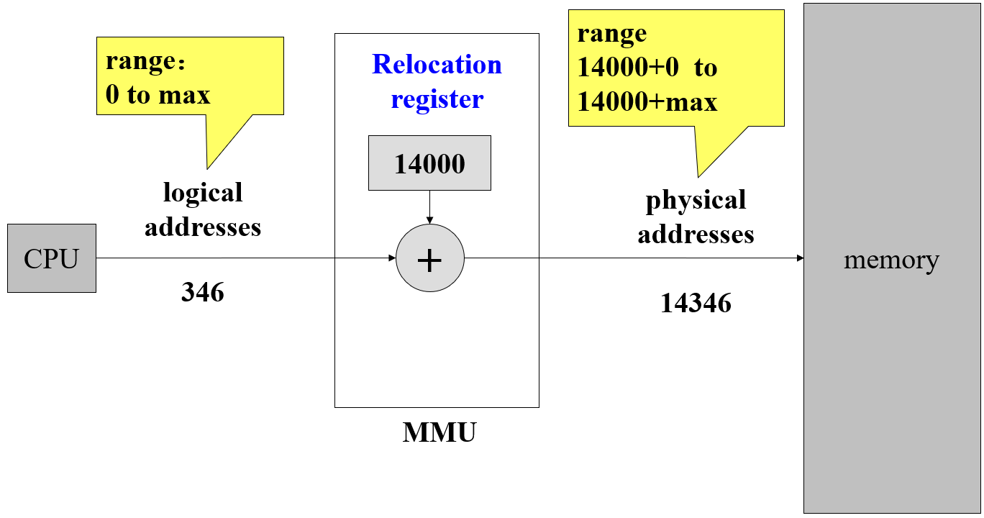
Memory-Management Unit (MMU)
Dynamic Relocation Using a Relocation Register
Hardware device -- maps virtual address to physical address in run-time
Consider a simple MMU scheme using base-register.
Base register now is called relocation register.
The value in the relocation register is added to every address generated by a user process at the time it is sent to memory.
The user program deals with logical addresses; it never sees the real physical addresses.
Execution-time binding occurs when reference is made to location in memory.

Slide 18
Dynamic Loading (*)
Routine is not loaded until it is called.
Unused routine is never loaded.
Useful when large amounts of code are needed to handle infrequently occurring cases, such as error routines.
Better memory-space utilization.
Main program is loaded into memory and is executed.
all routines are kept on disk in a relocatable load format.
When needed, the relocatable linking loader is called.
No special support from the OS is required
implemented through program design.
OS can help by providing libraries to implement dynamic loading.
简单的了解一下

Slide 19
Dynamic Linking and Shared Libraries (*)
Static linking – system libraries and program code are combined by the loader into the binary program image.
Dynamic linking – Linking is postponed until execution time.
A stub is included in the image for each library-routine reference.
stub, a small piece of code, indicates how to locate the appropriate memory-resident library routine, or how to load the library if the routine is not already present.
When executed, the stub replaces itself with the address of the routine, and executes the routine.
Dynamic linking generally requires help from the OS.
OS checks if routine is in processes’ memory address.
If not in address space, add to address space.

Slide 20
Dynamic Linking and Shared Libraries (*)
Dynamic linking is particularly useful for libraries.
A library may be replaced by a new version, and all programs that reference the library will automatically use the new version.
Shared libraries
Consider applicability to patching system libraries
Versioning may be needed.
Version information is included in both the program and the library, so that programs will not accidentally execute new, incompatible versions of libraries.
More than one version of a library may be loaded into memory, and each program uses its version information to decide which copy of the library to use.

Slide 21
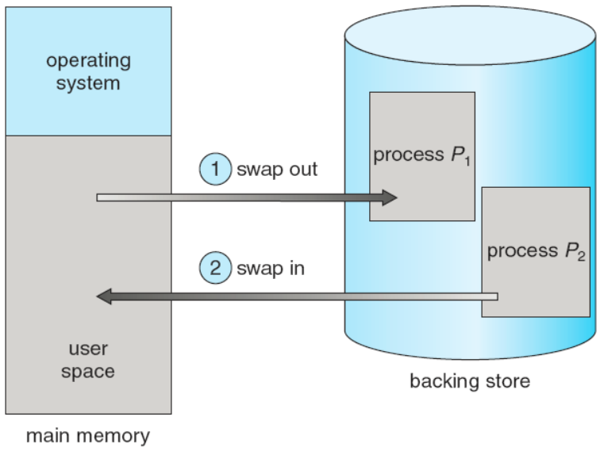
8.2 Swapping
A process can be temporarily swapped out of memory to a backing store, and then brought back into memory for continued execution.
Total physical memory space of processes can exceed physical memory.
Backing store – fast disk, large enough to accommodate copies of all memory images for all users; must provide direct access to these memory images.
Will the swapped out process be swapped back to the same memory space it used before?
Depends on address binding method.

Slide 22
Swapping
Roll out, Roll in – swapping variant used for priority-based scheduling algorithms.
Lower-priority process is swapped out so higher-priority process can be loaded and executed.
ready queue — Consists of all processes whose memory images are on the backing store or in memory and are ready to run.
Dispatcher is called whenever the CPU scheduler decides to execute a process.
checks to see whether the next process in the queue is in memory.
If not, and if there is no free memory region, the dispatcher swaps out a process currently in memory and swaps in the desired process.

Slide 23
Swapping
Context switch time can be very high.
Major part of swap time is transfer time.
E.g. 100MB process swapping to hard disk with transfer rate of 50MB/sec
Swap out time of 2000 ms
Plus swap in of same sized process
Total swap time is about 4000ms (4 seconds)
Total transfer time is directly proportional to the amount of memory swapped.
Be useful to know exactly how much memory a user process is using, not simply how much it might be using.
The user must keep the system informed of any changes in memory requirements.
System calls: request_memory() and release_memory().

Slide 24
Swapping
Ensure the process be swapped out is completely idle.
Solution to pending I/O
Never swap a process with pending I/O.
Execute I/O operations only into OS buffers. Known as double buffering, adds overhead.
Standard swapping is not used in modern OSs.
Modified versions of swapping are found on many systems, i.e., UNIX, Linux, and Windows.
Swap only when free memory extremely low.
Swapping normally disabled, Started if the amount of free memory falls below a threshold amount, Halted when the amount of free memory increases.

Slide 25
Overlays
Keep in memory only those instructions and data that are needed at any given time.
symbol
table
20K
common
routines
30K
overlay driver
10K
pass 1
pass 2
70K
80K

Slide 26
Overlays
Needed when process is larger than amount of memory allocated to it.
Implemented by user.
No special support needed from operating system.
Programming design of overlay structure is complex.
This task can be a major undertaking, requiring complete knowledge of the structure of the program, its code, and its data structures.
limited to microcomputer and other systems that have limited amounts of physical memory and that lack hardware support for more advanced techniques.

Slide 27
覆盖与交换技术——扩充内存的两种方法
覆盖技术
当用户程序所需要的内存空间比分配给它使用的内存空间大时，可以使用覆盖技术。
由程序员实现，不需要OS特别支持
思想：把程序划分为若干个功能上相对独立的程序段，按照程序的逻辑结构让那些不会同时执行的程序段共享同一块内存区域。
对程序员要求很高
必须十分清楚程序的逻辑结构
明确规定各程序段的执行和覆盖顺序。
设计实现覆盖驱动模块。
交换技术
由OS中的交换程序实现，对用户透明。
swap out：将内存某区域中的进程调出内存写入外存交换区。
swap in：从外存交换区中把指定的进程调入内存，并让它执行。
交换与覆盖的区别
覆盖技术要求程序员自己设计覆盖结构，交换对用户是透明的。
交换主要是在进程和进程之间进行，覆盖则是在同一进程内进行。

Slide 28
8.3 Contiguous Memory Allocation
must accommodate both OS and user processes.
memory is usually divided into two partitions:
OS, usually held in low memory with interrupt vector.
User processes, held in high memory.
User space is divided into Multiple partitions.
Single-partition allocation for each process.
Relocation-register scheme used to protect user processes from each other, and from changing operating-system code and data.
Relocation/base register contains the value of the smallest physical address;
limit register contains the range of logical addresses . Each logical address must be less than the limit register.

Slide 29
Memory Protection
空间安全
合法访问
越界制裁
limit
register
relocation
register
memory
logical
address
physical
address
CPU
<
yes
+
no
trap; addressing error
MMU maps logical address dynamically.
The dispatcher loads the relocation and limit registers.

Slide 30
Contiguous Memory allocation -- Fixed Partitioning
The degree of multiprogramming is bound by the number of partitions.
Equal-size partitions
Any process whose size is less than or equal to the partition size can be loaded into an available partition.
All partitions are full, OS can swap a process out of a partition.
A program may not fit in a partition, the programmer must design the program with overlays.
Unequal-size partitions
Memory use is inefficient.
Any program, no matter how small, occupies an entire partition. This results in internal fragmentation.

Slide 31
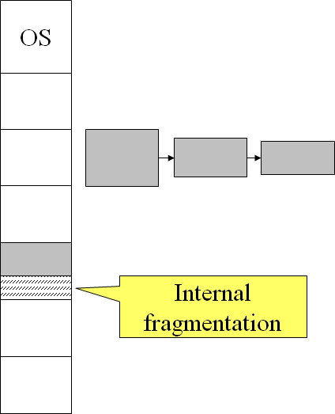
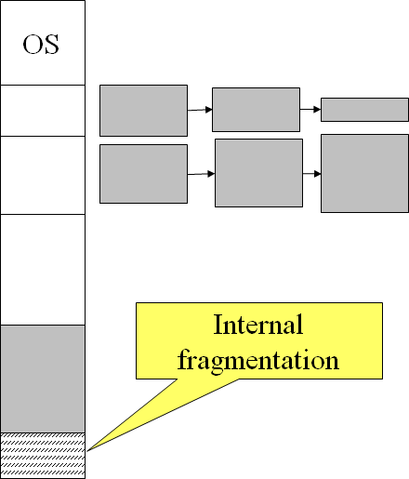
Placement Algorithm with Partitions
Equal-size partitions
All partitions are of equal size, it does not matter which partition is used.
Unequal-size partitions
Can assign each process to the smallest partition within which it will fit.
Queue for each partition.
Processes are assigned in such a way as to minimize wasted memory within a partition.
Data structure?
Partition_id, base address, limit, status.

Slide 32
Contiguous Memory allocation --Variable-partition scheme
Dynamic Partitioning (called MVT)
Partitions are of variable length and number.
Hole – a block of available memory.
Initially, all memory is available for user processes, a large hole.
Holes of various size are scattered throughout memory.
The OS maintains a table containing information:
Which partitions are allocated, and to which process.
Which partitions are free (hole)
Memory allocation and reclaim
When a process arrives, it is allocated memory from a hole large enough to accommodate it. Process is allocated exactly as much memory as required.
Process exiting frees its partition, adjacent free partitions combined.

Slide 33
Variable-partition scheme
OS
OS
OS
OS
P5
P5
P5
P8
P9
P6
P10
P10
P4
P2
P2
P2
a list of available block sizes, and the input queue.
A large hole is split into two parts: one is allocated to the process, the other is returned to the set of holes.
Many small holes in the memory, external fragmentation.
Can use compaction to shift processes so they are contiguous and all free memory is in one block.
Data structure: Base address, limit

Slide 34
Dynamic Storage-Allocation Problem
How to satisfy a request of size n from a list of free holes?
First-fit: Allocate the first hole that is big enough.
Best-fit: Allocate the smallest hole that is big enough.
must search the entire list, unless ordered by size.
Produces the smallest leftover hole.
Worst-fit: Allocate the largest hole.
must also search the entire list.
Produces the largest leftover hole.
First-fit and best-fit are better than worst-fit in terms of speed and storage utilization.
These algorithms suffer from external fragmentation.

Slide 35
Fragmentation
External Fragmentation – total memory space exists to satisfy a request, but it is not contiguous.
Internal Fragmentation – allocated memory may be slightly larger than requested memory; this size difference is memory internal to a partition, but not being used.
Statistical analysis of first fit reveals that given N blocks allocated, another 0.5 N blocks will be lost to fragmentation.
1/3 of memory may be unusable -> 50-percent rule.

Slide 36
Fragmentation
Reduce external fragmentation by compaction.
Shuffle memory contents to place all free memory together in one large block.
Compaction is possible only if relocation is dynamic, and is done at execution time.
I/O problem
Latch job in memory while it is involved in I/O.
Do I/O only into OS buffers.
Backing store has same fragmentation problems.

Slide 37
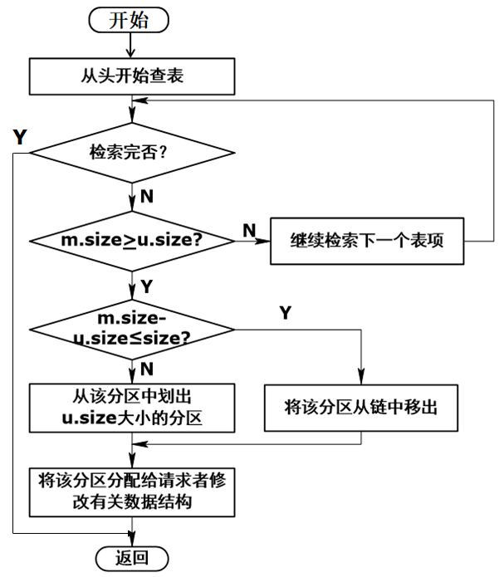
分配流程
m.size: hole size
u.size: process size
size: threshold
理论上：按需分配
实际上：考虑成本

Slide 38
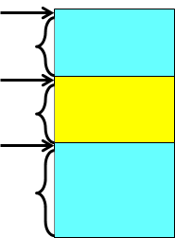
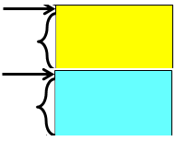
动态分区的回收
进程终止，OS 收回其内存空间，并插入空闲分区表/链中。
考虑内存中与其上下相邻的存储空间的状态，如有空闲分区，则进行合并。
上下相邻分区的状态
上下邻分区均空闲
更新上邻区记录的长度=上邻区长度 + 释放区长度+下邻区长度
从表/链中删除下邻区的记录
上邻分区空闲：更新上邻区记录的长度=上邻区长度+释放区长度
下邻分区空闲
更新下邻区记录的长度=释放区长度+下邻区长度
更新下邻区记录的起始地址=释放区的起始地址
上下邻分区均非空闲：为释放区在表/链中适当的位置建立记录

Slide 39
First fit 首次适应法
按空闲区首地址递增的次序组织空闲区表(队列)。
分配：
从空闲区表的第一个表项/或上次分配结束时的位置开始查询，遇到满足要求的空闲区，从中分配。
回收：
按释放区的首地址查询空闲区表，
若有与释放区相邻的空闲区，则合并到相邻的空闲区中，并修改该区的大小和首地址。
否则，把释放区作为一个空闲区，将其大小和首地址按照首地址大小递增的顺序插入到空闲区表的适当位置。

Slide 40
Best fit 最佳适应法
按空闲区大小递增的次序组成空闲区表/队列。
选中的空闲区是满足要求的最小空闲区。
分配：
从表头开始查找，找到第一个满足要求的空闲区，从中分配。
回收：
按释放区的首地址查询空闲区表/队列，
若有与释放区相邻的空闲区，则合并到相邻的空闲区中，并修改该区的大小和首址。
否则，把释放区作为一个空闲区插入空闲区表/队列。
分配和回收后要对空闲区表/队列重新排序。

Slide 41
Worst fit 最坏适应法
按空闲区大小递减的顺序组织空闲区表/队列。
分配：
检查空闲区表的第一个空闲区的大小是否满足要求。 若不满足，则分配失败；满足的话，则从中分配。
回收：
按释放区的首地址查询空闲区表/队列
若有与释放区相邻的空闲区，则合并到相邻的空闲区中，并修改该区的大小和首址。
否则，把释放区作为一个空闲区插入空闲区表/队列。
分配和回收后要对空闲区表/队列重新排序。

Slide 42
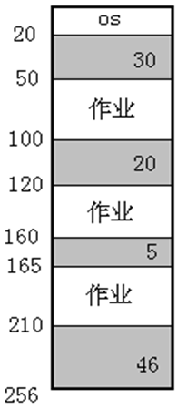
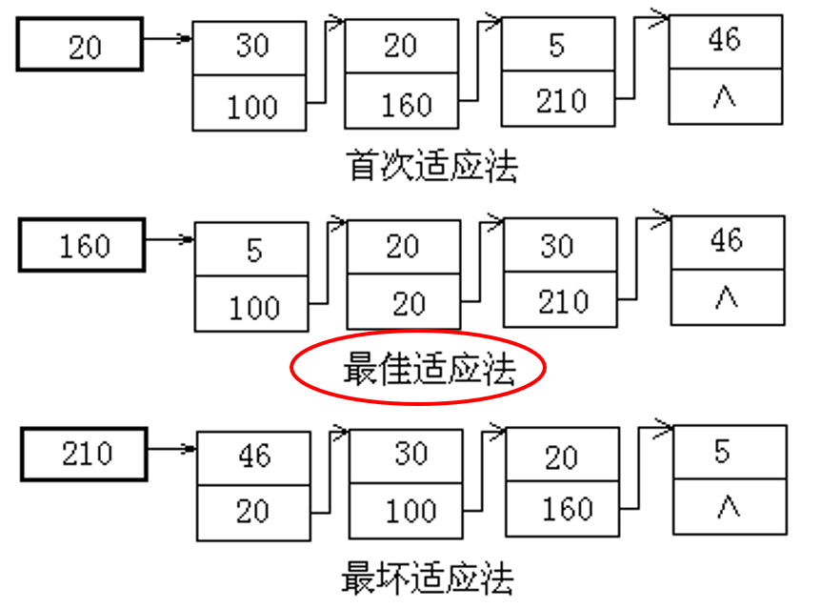
Exercise 1
某系统，内存状态如右所示。有如下作业序列：
A需要内存18M，B需要25M，C需要30M。
根据分析结果回答：哪种分配算法对此作业序列是合适的？

Slide 43
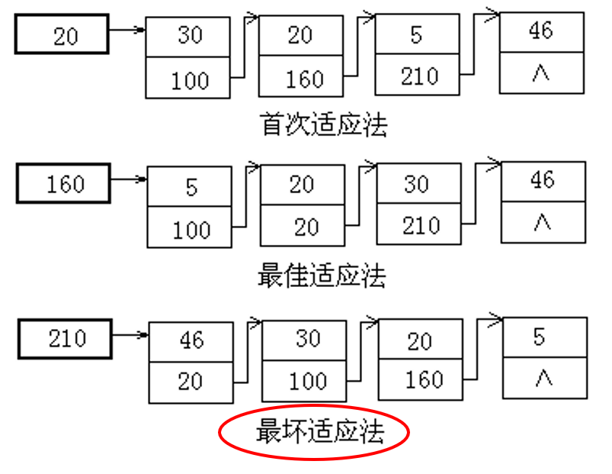
Exercise 2
某系统，内存状态如右所示。有如下作业序列：
A需要内存21M，B需要30M，C需要25M。
根据分析结果回答：哪种分配算法对此作业序列是合适的？

Slide 44
Exercise 3
用可变分区(动态重定位)方式管理内存时，假定内存中按地址顺序依次有5个空闲区，空闲区的大小依次为：32M、10M、5M、228M和100M。 现在有5个作业A、B、C、D、E。它们各需主存大小为：1M、10M、108M、28M和115M。 问： 采用哪种算法能把这5个作业按顺序全部装入内存?

Slide 45
Answer to Exercise 3
32M、10M、5M、228M、100M
A: 1M
B: 10M
C: 108M
D: 28M
E: 115M
Best fit:
First fit:
Worst fit:

Slide 46
8.4 Paging
Process's physical address space can be noncontiguous.
The basic method for implementing paging:
Physical memory is divided into fixed-sized blocks, frames.
Logical memory is divided into blocks of same size, pages.
Backing store is divided into fixed-sized blocks that are of the same size as the memory frames.
size is power of 2, between 512B and 16MB.
When a process is to be executed, its pages are loaded into any available frames from the blocks.
Process is allocated memory frames whenever the latter is available.
Avoids external fragmentation.
Avoids problem of varying sized memory chunks.

Slide 47
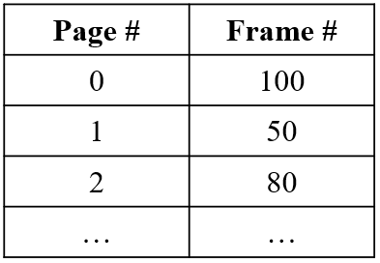

Paging
Keep track of all free frames.
To run a program of size n pages, need to find n free frames and load program.
OS maintains a page table for each process.
contains the frame location for each page in the process.
used to translate logical to physical addresses.
Internal fragmentation. (-- the last page)
Every logical address is divided into:
Page number (p) – used as an index into a page table which contains the base address of each page in physical memory.
Page offset (d) – combined with base address to define the physical memory address that is sent to the memory unit.
data structure?

Slide 48
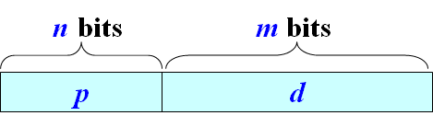
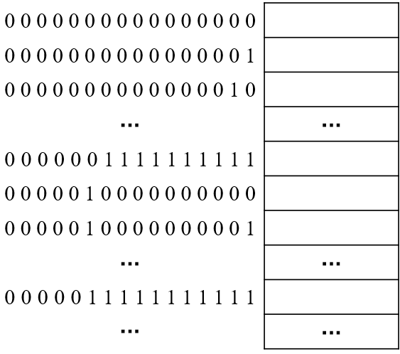
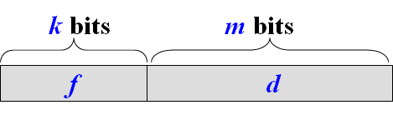
Address structure
Logical address
two part：p -- page number, d -- offset
bits of p：decided by the number of pages
bits of d：decided by the size of page
bits of logical address：n+m
Physical address
two part：f -- frame number, d -- offset
bits of f：decided by the number of memory frames
bits of d：decided by the size of frame/page
bits of physical address：k+m

Slide 49
Exercise 4
Consider a system with physical memory of 2048 frames, the logical address space of a process is up to 32 pages, the page size is 2048 bytes.
(1) How many bits are there in the logical address?
(2) How many bits in the logical address refer to virtual page number?
(3) How many bits are there in the physical address?
(4) How many bits in the physical address refer to frame number?
(5) How many bits in the physical address refer to offset in a frame?
16
5
22
11
11

Slide 50
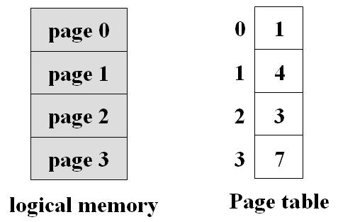
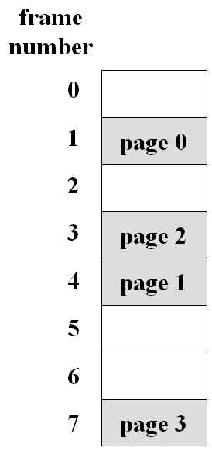
Paging model
The size of a page is typically a power of 2, varying between 512 bytes and 16MB per page
page number page offset
p d
m-n bits n bits

Slide 51
Address Translation Architecture
logical
address
physical
address
f
f 0000…0000
CPU
P d
f d
p
f 1111…1111
+
f
physical memory
PTBR
page table

Slide 52
Example of Address Mapping
Page size: 1KB, a process can have 8 pages, there are 64 frames.
Length of logical address (LA) is 13bits（3+10）
Length of physical address (PA) is 16bits（6+10）
LA: 2500 = 2*1024+452 ➔ 010 0111000100
PA: 001000 0111000100 ➔ 8*1024+452=8644
PTLR PTBR
010 0111000100
Logical address
000
001
010
000010
000011
001000
001000 0111000100
Physical address

Slide 53
Example of Address Mapping
Page size: 64W Physical memory: 300 frames
64*51+36=3300
Logical space
Page#
0
1
2
3
4
Frame#
100
51
42
203
154
000110011100100
0
……
Load R1, [200]
……
6817
……
0~63
100
64
100
64~127
001100100
128~191
p d
200
64
200
011001000
192~255
299
256~299
319
011001011001000
Internal fragmentation 20W
64*203+8=13000

Slide 54
Exercise 5
A certain computer provides its users with a virtual-memory space of 2³² bytes. The computer has 2¹⁸ bytes of physical memory. The virtual memory is implemented by paging, and the page size is 4,096 bytes.
(1) How many bits are there in the logical address?
(2) How many bits in the logical address refer to virtual page number?
(3) How many bits are there in the physical address?
(4) How many bits in the physical address refer to frame number?
(5) How many bits in the physical address refer to offset in a frame?
(6) A user process generates the virtual address 11123456, figure out its page number and page offset.
Explain how the system establishes the corresponding physical location.
32
20
18
6
12
2715 2816直接除

Slide 55
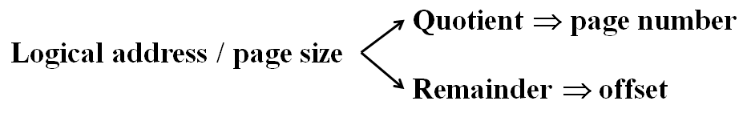
Exercise 6
Assuming a 1-KB page size, what are the page numbers and offsets for the following address references (provided as decimal numbers):
a. 3085
b. 42095
c. 215201
d. 650000
e. 2000001
 | page number | offset
a | 3 | 13
b | 41 | 111
c | 210 | 161
d | 634 | 784
e

Slide 56
Fragmentation
Has no external fragmentation
Has internal fragmentation, e.g.
Page size = 2,048 bytes
Process size = 72,766 bytes
35 pages + 1,086 bytes
Internal fragmentation of 2,048 - 1,086 = 962 bytes
Worst case fragmentation = 1 frame – 1 byte
On average fragmentation = 1 / 2 frame size
So small frame sizes desirable?
More page table entries needed, each page table entry takes memory
Page sizes growing over time
Solaris supports two page sizes – 8 KB and 4 MB

Slide 57
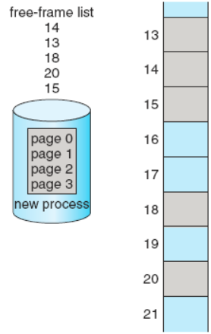
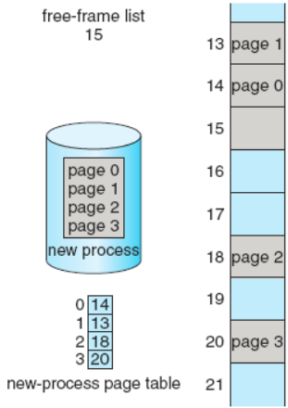
Free Frames
before allocation
after allocation

Slide 58
Hardware support
A set of registers used for page-table (<256 entries)
For large page-table (e.g. 1 million entries), Page table is kept in main memory.
Page-table base register (PTBR) points to the page table.
Page-table length register (PTLR) indicates size of the page table.
In this scheme every data/instruction access requires twice memory access. One for the page table entry and one for the data/instruction.
The twice memory access problem can be solved by the use of a special, small, fast-lookup hardware cache, called translation look-aside buffers (TLBs), or associative memory.
Functions same way as a memory cache.

Slide 59
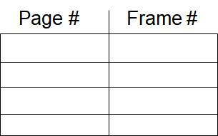
TLB --Translation Look-aside Buffer
TLB is associative, high-speed memory.
Contains page table entries that have been most recently used.
Each entry in the TLB consists of two parts: a key and a value. (page #, frame #)
Given a logical address, processor examines the TLB.
The given page number is compared with all keys simultaneously.
If page table entry is found (a hit), the frame number is retrieved and the physical address is formed.
If page table entry is not found in the TLB (a miss), the page number is used to index the process page table.

Slide 60
Paging Hardware With TLB
LA
CPU
P d
f
P# F#
TLB hit
f 0000…0000
PA
d
f
TLB
f 1111…1111
p
f
TLB miss
更新 TLB
physical memory
page table

Slide 61
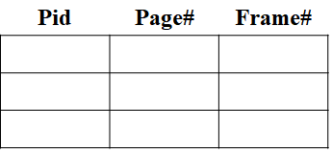
TLB
On a TLB miss, value is loaded into the TLB for faster access next time.
TLBs typically small (64 to 1,024 entries).
Replacement policies must be considered (e.g. LRU).
Some entries can be wired down for permanent fast access e.g. entries for key kernel code.
Process Context Switching
Some TLBs store address-space identifiers (ASIDs) in each TLB entry.
ASID uniquely identifies each process, and is used to provide address-space protection for that process.
ASID allows the TLB to contain entries for several different processes simultaneously.

Slide 62
Effective Access Time (EAT)
Hit ratio – percentage of times that a page number is found in the associative registers; ration related to number of associative registers.
Associative Lookup = ε nanoseconds
Assume memory cycle time is τ nanoseconds
Hit ratio = α
Effective Access Time (EAT)
EAT = (ε + τ) α + (ε + 2τ)(1 – α)
= 2 τ + ε – τ α
ε=20ns, τ=100ns, α=0.8, EAT=140ns
ε=20ns, τ=100ns, α=0.98, EAT=122ns

Slide 63
Exercise 7
Consider a paging system with the page table stored in memory.
if a memory reference takes 200 nanoseconds, how long does a paged memory access take?
If we add TLBs, and 75 percent of all page-table references are found in the TLBs, what is the effective memory access time? (Assume that finding a page-table entry in the TLBs takes 4 time, if the entry is there.)
400
(4+200)*0.75+0.25*404

Slide 64
Memory Protection
Memory protection implemented by associating protection bit with each frame.
Normally these bits are kept in the page table.
RW bit, can define a page to be read-write or read-only.
Can also add more bits to indicate page execute-only, and so on.
Valid-invalid bit attached to each entry in the page table.
“valid” indicates that the associated page is in the process’ logical address space, and is thus a legal page.
“invalid” indicates that the page is not in the process’ logical address space.
Or use page-table length register (PTLR).
Any violations result in a trap to the kernel.

Slide 65
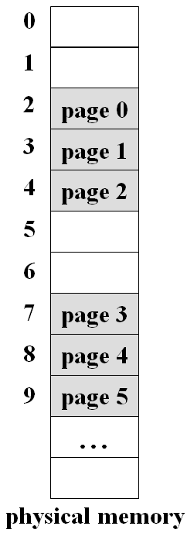
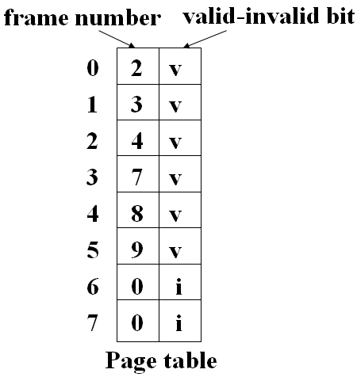
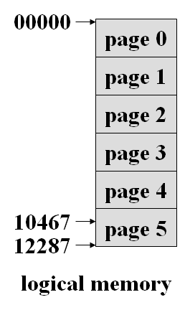
Valid(v)-Invalid(i) Bit
In a system with a 14-bit address space (0 to 16383), page size of 2 KB. A program with size 10468B.
1820B internal fragmentation

Slide 66
Shared Pages
Shared code
One copy of read-only (reentrant) code shared among processes (i.e., text editors, compilers, window systems).
Shared code must appear in same location in the logical address space of all processes.
Similar to multiple threads sharing the same process space.
Also useful for interprocess communication if sharing of read-write pages is allowed.
Private code and data
Each process keeps a separate copy of the code and data.
The pages for the private code and data can appear anywhere in the logical address space.

Slide 67
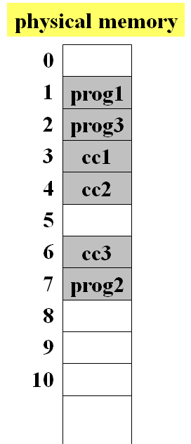
Shared Pages Example
cc1
cc1
cc1
cc2
cc2
cc2
cc3
cc3
cc3
prog1
prog2
prog3
process P₁
process P₂
process P₃
logical memory
3
3
3
Same
Logical address
4
4
4
6
6
6
1
7
2
page table
for P₁
page table
for P₂
page table
for P₃
page table

Slide 68
8.5 Structure of Page Table
Consider a 32-bit logical address space as on modern computers，with 4 KB Page size.
How many page table entries?
If each entry consists of 4 bytes, the size of the page table?
Don't want to allocate that contiguously in main memory.
Divides the page table into small pieces.
Hierarchical Paging
Hashed Page Tables
Inverted Page Tables
1 million entries (2³² / 2¹² =2²⁰)
2²⁰ *4B=4 MB, needs 2¹⁰ frames

Slide 69
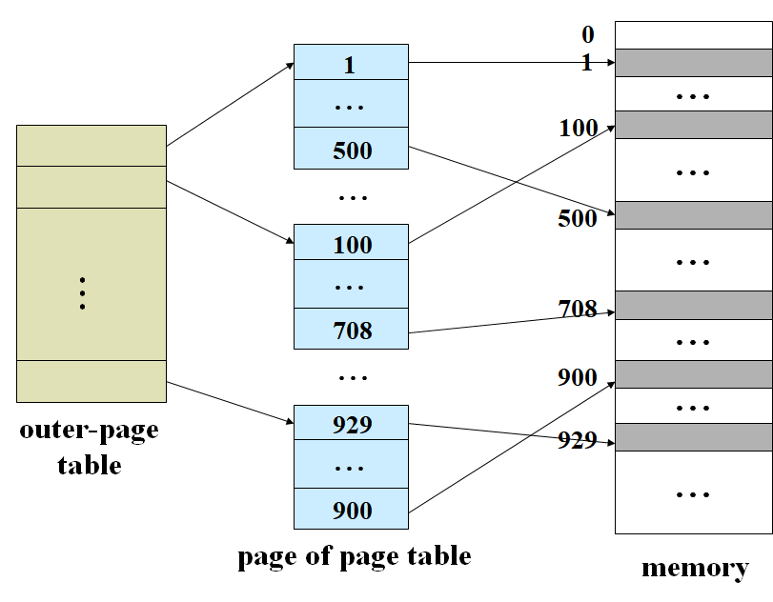
Hierarchical Paging
A simple technique is a two-level paging algorithm.
the page table itself is also paged.
PTBR
PTLR

Slide 70
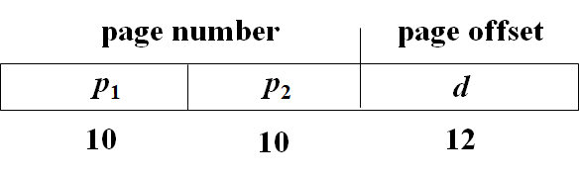
Two-Level Paging Example
A logical address (on 32-bit machine with 4KB page size) is divided into:
a page number consisting of 20 bits.
a page offset consisting of 12 bits.
Since the page table is paged, the page number is further divided into:
a 10-bit page number.
a 10-bit page offset.
A logical address is as:
p₁ is an index into the outer page table
p₂ is the displacement within the page of the inner page table.

Slide 71
Address-Translation Scheme
Address-translation scheme for a two-level 32-bit paging architecture.
forward-mapped page table.
Logical address
p₁ p₂ d
p₁
frame_p
p₂
frame_d
outer-page
table
d
page of
page table
memory

Slide 72
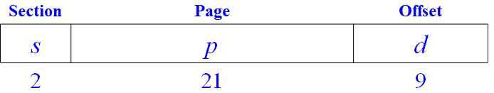
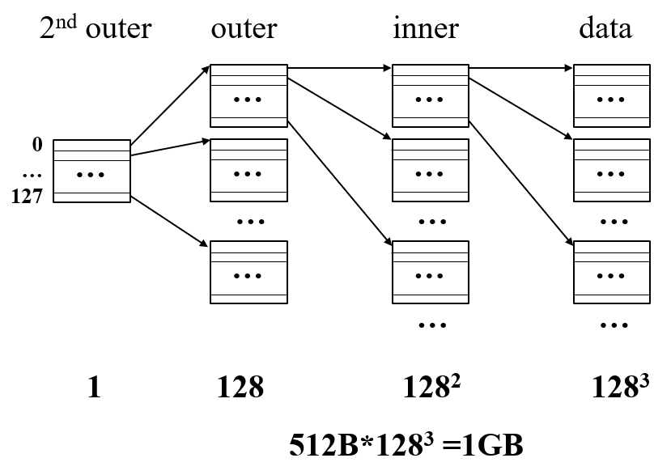
e.g. VAX Architecture
32-bit machine with a page size of 512 bytes.
The logical address space of a process is divided into 4 equal sections, each of which consists of 2³⁰ bytes.
An address on the VAX architecture:
The size of a one-level page table for a VAX process using one section is:
2²¹ * 4 bytes per entry =8 MB, 2¹⁴ frames
3-level paging architecture
2nd outer: 1 frame, outer: 128 frames, inner: 128*128 frames
7b | 7b | 7b

Slide 73
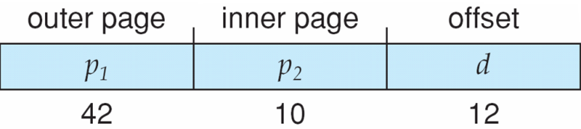
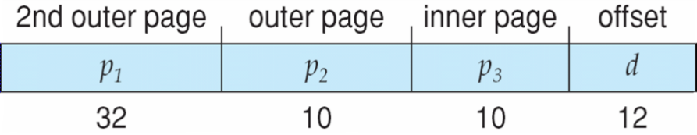
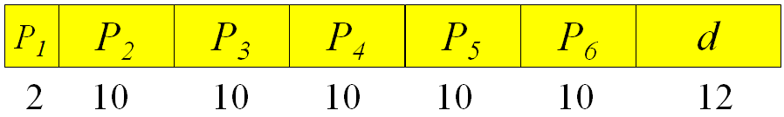
64-bit Logical Address Space
If page size is 4 KB (2¹²)
Then page table has 2⁵² entries.
If two level scheme, inner page tables could be 2¹⁰ 4-byte entries.
Outer page table has 2⁴² entries.
Solution：add a 2nd outer page table.
The 2nd outer page table is still 2³² bytes in size.
The 2nd outer page table is also paged.
…
7 levels of paging is required to translate each logical address.
A prohibitive number of memory accesses.

Slide 74

Hashed Page Tables
Common in address spaces > 32 bits.
Each hash table entry contains a linked list of elements that hashed to the same location.
Each element consists of three fields:
(1) The virtual page number
(2) The value of the mapped page frame (frame number)
(3) A pointer to the next element in the linked list
The logical page number is hashed into the hash table, and is compared to field (1) in this chain searching for a match.
If a match is found, the corresponding physical frame number (field 2) is extracted.
If there is no match, subsequent entries in the linked list are searched for a matching logical page number.

Slide 75
Hashed Page Tables
logical address
physical address
d
P d
r
memory
hash
function
…
q s
p r
hash table

Slide 76

Inverted Page Table
One entry for each real frame of memory.
Each entry consists of the virtual address of the page stored in that real memory location, with information about the process that owns that page.
an address-space identifier (ASID) stored in each entry of the page table.
A simplified version of the implementation used in the IBM RT, each virtual address consists of a triple:
< process-id, page-number, offset >

Slide 77
Inverted Page Table Architecture
physical
memory
logical address
physical address
CPU
pid
p
d
i
d
search
i
pid
p
Page table

Slide 78
Inverted Page Table Architecture
Decreases the amount of memory needed to store each page table, but increases the amount of time needed to search the table when a page reference occurs.
Use hash table to limit the search to one — or at most a few — page-table entries.
TLB can accelerate access
How to implement shared memory?
One mapping of a virtual address to the shared physical address

Slide 79
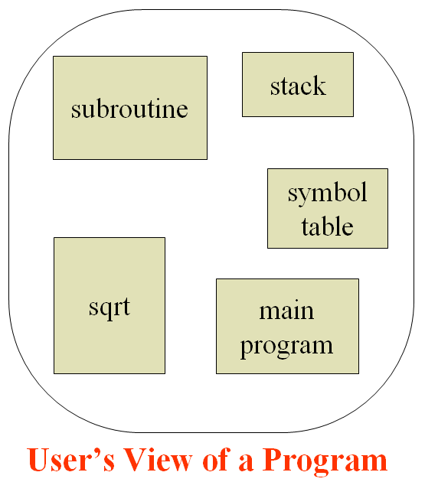
8.6 Segmentation
A program is a collection of segments. A segment is a logical unit such as:
main program
Procedure / function / method
common block
Object
Stack / symbol table / arrays
local variables / global variables
Segments vary in length.
Elements within a segment are identified by their offset from the beginning of the segment.
Segmentation is a memory-management scheme that supports this user view of memory.
Each segment has a name and a length.

Slide 80
Segmentation Architecture
Logical address: a segment number and an offset, <segment-number, offset>
Segment table -- maps two-dimensional user-defined addresses into one-dimensional physical addresses; each table entry has:
Segment base – contains the starting physical address where the segment resides in memory.
Segment limit – specifies the length of the segment.
Segment-Table Base Register (STBR) points to the segment table’s location in memory.
Segment-Table Length Register (STLR) indicates number of segments used by a program.
segment number s is legal if s < STLR.

Slide 81
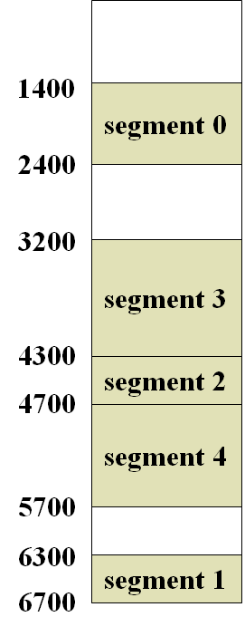
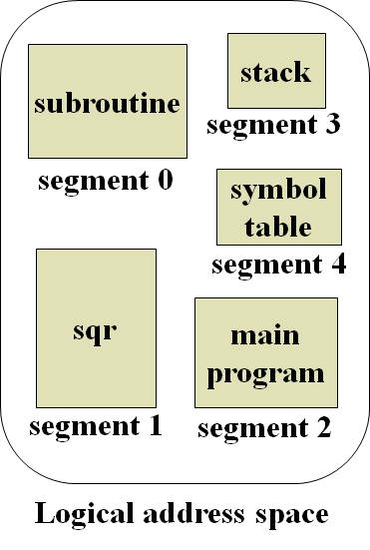
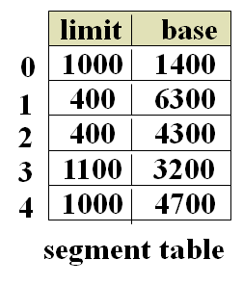
Example of Segmentation
STBR
STLR
=5

Slide 82
Segmentation Hardware
STBR
s
STLR
<
limit
base
No
trap
physical
memory
CPU
s
d
segment table
Yes
<
+
No
trap; addressing error

Slide 83
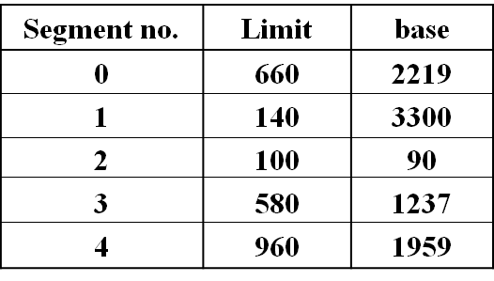
Exercise 8
Segment table：
mapping logical address to physical address: [0, 432]， [1, 10]， [2, 500]， [3, 400]
Summarize the procedure that mapping a logical address to physical address.

Slide 84
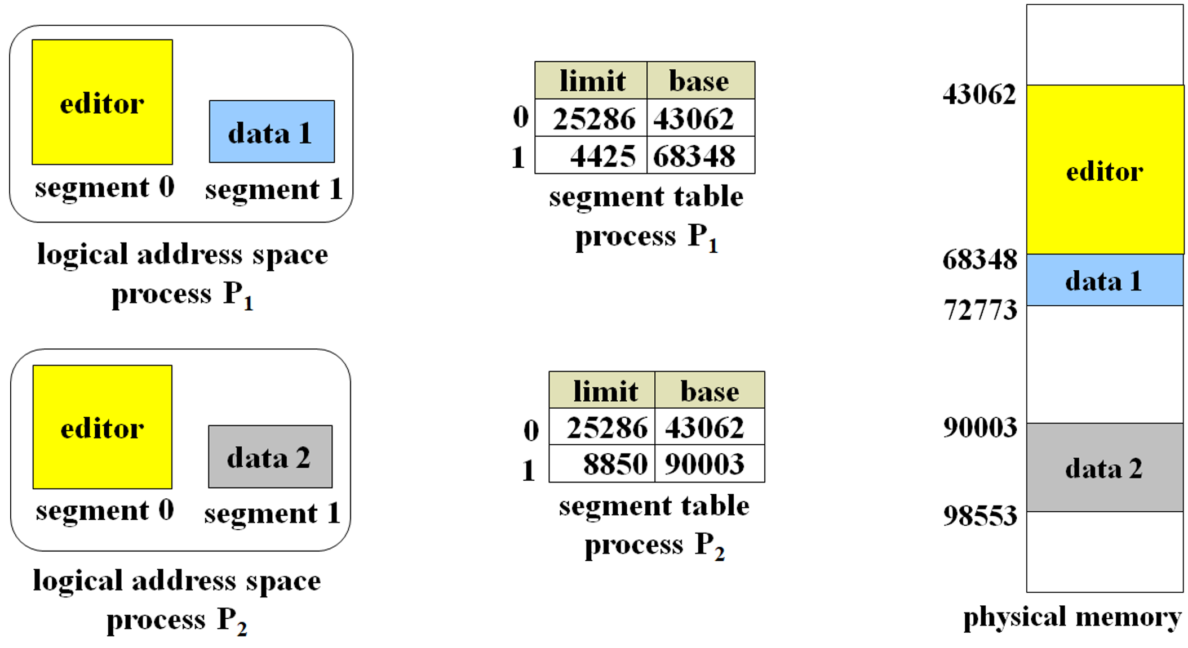
Segmentation Architecture
Relocation
dynamic
by segment table
Allocation
first fit / best fit
external fragmentation
External fragmentation on backing store
compaction
Sharing
at segment level
shared segments
same segment number
Protection. associated with segments.
With each entry in segment table associate
validation bit = 0 ⇒ illegal segment
read/write/execute privileges

Slide 85
Segmentation With Paging 段页式
页式存储管理的特点
内存分配单位：内存块frame； 没有外部碎片、且内部碎片也很少，有利于提高内存利用率。
不能兼顾程序本身的逻辑结构，难于实现代码段/数据段的共享。
段式存储管理的特点
程序采用二维的地址空间，能够反映程序的逻辑结构，便于实现存储保护和共享。
内存分配单位：段； 没有内部碎片，会出现较多的外部碎片，不利于提高内存利用率。
解决方法：段页式存储管理
段式+页式
物理内存管理：页式
程序逻辑地址空间：分段+分页
进程中具有独立逻辑功能的程序或数据仍被划分成段。
各段再分页。
每个段的各页可以装入内存中不连续的页面中。

Slide 86
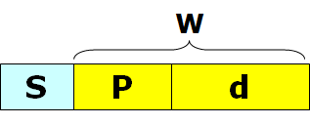
Segmentation With Paging 段页式
虚拟地址的构成
进程的逻辑地址空间划分成段， 每个段有自己的段号S。
段内的代码或数据，按照内存页面的大小划分为若干页。
逻辑地址包括三部分：段号S、页号P、以及页内地址d。
程序员可见：段号S、段内相对地址W。
页号P和页内地址d是由地址变换机构根据W生成的。
主要数据结构：段表和页表
每个进程有一张段表
管理内存的分配与释放、存储保护和地址变换等。
每个表项记录对应段的页表的起始地址和页表长度。
每个段有一张页表
保存段中的每个逻辑页在物理内存中的内存块号
段表、页表与内存之间的关系

Slide 87
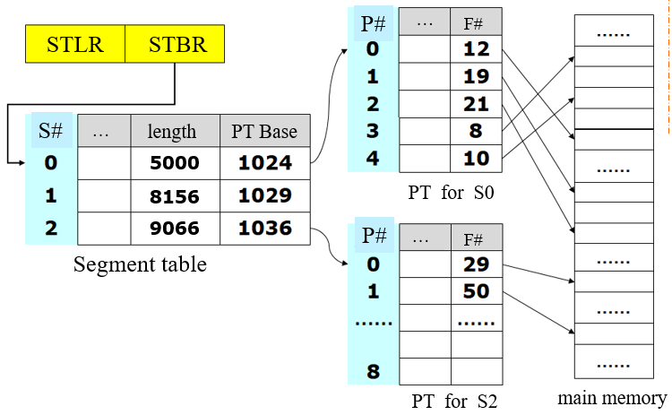
段表、页表与内存之间的关系示例

Slide 88
Address Translation Scheme
logical address
三次内存访问：
段表
页表
内存
s
d
yes
>
segment
length
page-table
base
no
+
trap
d
segment table
p
d'
memory
STBR
+
f
f
d'
physical address
page table for Segment s

Slide 89

TLB 快表
对内存中指令或数据进行一次存取的话，至少需要访问三次以上的内存。
设置TLB表，存放当前最常用的段号S、页号P和对应的内存块号F。
当要访问内存时，首先根据段号S和页号P在TLB中查找。
TLB命中：取出对应的内存块号F、拼接物理地址、访问内存；
TLB失败：查找内存中的段表、页表、取得内存块号F，拼接物理地址，访问内存。 并将段号S、页号P、内存块号F存入TLB中。
EAT=(ε+τ)*α + (ε+3τ)*(1-α)

Slide 90
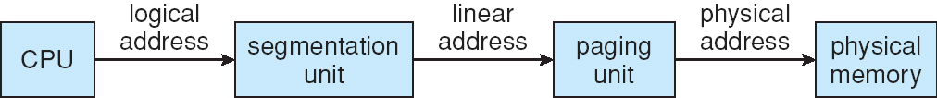
8.7 Example: The Intel Pentium
Supports both segmentation and segmentation with paging
CPU generates logical address
Given to segmentation unit, Which produces linear addresses
Linear address given to paging unit, Which generates physical address in main memory
The segmentation and Paging units form the equivalent of MMU.

Slide 91

课后作业及研究性学习
作业
内存中逻辑地址到物理地址的转换；
比较不同的内存管理模式。
研究性学习
国产内存产品调研，撰写调研报告。
openEuler
多级页表

Slide 92
openEuler 多级页表
openEuler中的多级页表
标准大页
标准大页池（Huge Page Pool）
伪文件系统：hugetlbfs
标准大页缺点及改进

Slide 93
openEuler中的多级页表
ARMv8架构最大支持48位虚拟地址，最大可寻址256TB的地址空间。
操作系统通过配置TCR_EL1的字段T0SZ和字段T1SZ可指定实际使用的用户空间和内核空间的大小。
在39位虚拟地址下，openEuler可使用：
3级页表（4KB页），或者2级页表（64KB页）
openEuler中，各级页表的表项大小：8B
页大小为4KB，每个frame可存放512项记录
4KB/8B=512=2⁹，需要9bits

Slide 94
openEuler中的多级页表
页表基础寄存器TTBR0_EL1和TTBR——EL1分别保存当前进程用户空间和内核空间的页表基址。
在39位虚拟地址下
虚拟地址的bit[62:39]为0，未用
Bit[63]=0，用户空间；Bit[63]=1，内核空间
地址转换过程
MMU将Lx索引的值作为x级页表内的偏移，据此查找对应的Lx表项，得到下一级页表的基址。
一级页表（页全局目录，Page Global Directory, PGD），其基址保存在TTBR0/1_EL1中。其中的目录项（PGDE）指向第二级页表（页中间目录，Page Middle Directory, PMD）。
第二级页表中存放目录项（PMDE），指向第三级页表（直接页表，Page Table），其中的目录项PTE记录了frame number。

Slide 95
标准大页
2³⁰
2²¹
2¹²

Slide 96
标准大页池（Huge Page Pool）
openEuler采用标准大页池的形式管理大页内存。
在内核启动时，根据用户的配置信息（大页长度、数量等）选择支持的大页长度，并预先在内存空间中预留出相应数量的大页。
结构体hstate记录大页的相关信息（页大小、空闲大页数量等），并将记录相同大页长度的结构体hstate组织成一个全局数组hstates进行管理

Slide 97
伪文件系统：hugetlbfs
openEuler将标准大页封装为一个伪文件系统，提供给用户程序申请使用。
使用之前，openEuler调用函数hugetlbfs_mount()挂载hugetlbfs文件系统，创建超级块和根目录，将该文件系统和大页内存关联起来。
Hugetlbfs指向大页所分配的内存。
用户从供需可利用简单文件编程接口使用标准大页。

Slide 98
标准大页缺点及改进
缺点：
数量和长度必须在内核启动时指定；
需要在内存中预留出大页池所需要的内存；
用户进程需要制定调用伪文件系统形式提供的接口来申请大页；
手动管理大页的申请和释放。
改进：透明大页
为用户进程分配内存时，优先选择分配大页，如果不成功，再回退到分配普通页
无足够的空闲内存，或者该虚拟地址区域不允许映射大页内存
缺页处理时，再遍历页表的过程中，OS依次检查该进程的L1和L2级页表中的表项是否为空表项
是，虚拟地址范围足够大，并且虚拟内存区域允许映射到透明大页，则将尝试为之分配一个大页并建立映射关系。
用户进程可指定某个虚拟内存区域是否允许映射到透明大页
非空或大页内存不足，分配普页。

